Slide 1

Truly Understanding Low-Power Multimedia Chip Design
Jonah Probell
Multimedia Systems Engineer
Tensilica

Slide 2
Distinguish Energy from Power
Amount of energy
Amount of power
Energy = Power consumed over time
Extending battery life of portable devices requires conserving energy, not necessarily reducing power

Slide 3
The Sweetest Fruit May Not Hang Low
A small improvement to a big contributor
helps more overall than
A big improvement to a small contributor
A
A
B
B
A
B
original problem
50% improvement to A
25% improvement to B

Slide 4
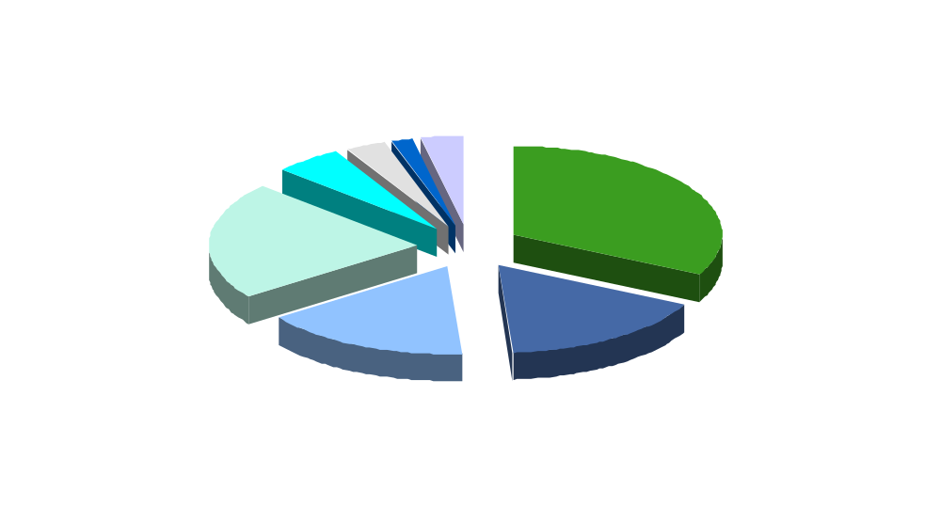
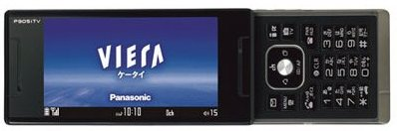
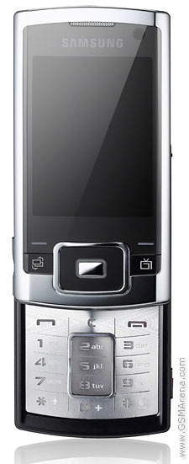
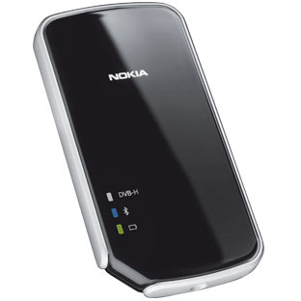
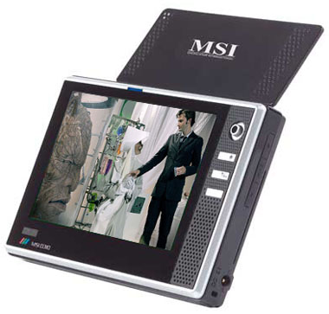
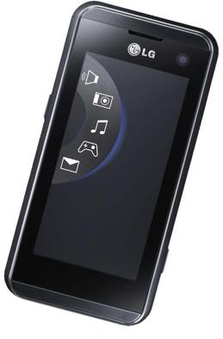
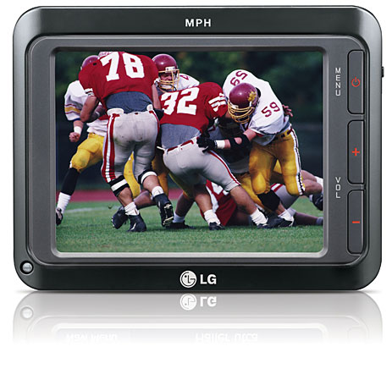
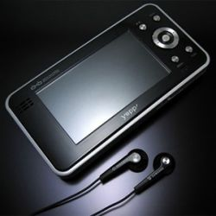
Energy Consumption In Systems
Composite portable multimedia device power estimate
SOC power

Slide 5
“Typical” Multimedia SOC
LCD Display
lens assembly
antenna
antenna
antenna
HDMI
out
flash memory
SOC
Flash
image sensor interface
LCD interface
DTV demod
baseband comms
modem
GPS demod
GPIOs
ethernet
DRAM memory
SDRAM controller
peripheral bridge
I2S
system interconnect
IDE
mic
speaker
AC97
SDIO
L2 Cache
host / control processor
audio codec
video image codec
graphics
image processing
USB
I2C
PCI

Slide 6

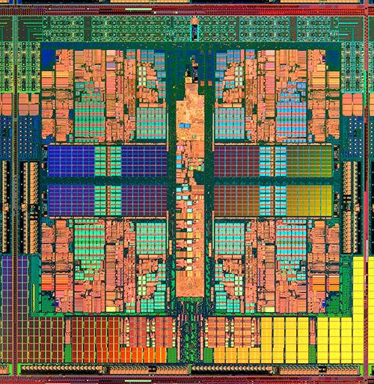
Energy Consumption In SOCs
SoC power estimate [3]
multi V_{T} and multi V_{DD} cells helps
clock gating is valuable!
wider memories requiring less frequent access
and memory segmentation with enables help

Slide 7
Memory Hierarchy Choices
main memory
chip
edge
L2 data cache
stream buffer
DMA
local data RAM
local data cache
CPU core

Slide 8
Example: Energy for MP3 file decode
RISC
CPU
energy consumed
standard
DSP
audio
DSP
e.g.
ARM9
MIPS4K
e.g.
ZSP200
CEVA-TeakLite-II
e.g.
Tensilica HiFi

Slide 9
Example: MP3 decode play time?
WARNING
misleading information
audio
DSP
play time
standard
DSP
RISC
CPU
e.g.
ARM9
MIPS4K
e.g.
ZSP200
CEVA-TeakLite-II
e.g.
Tensilica HiFi

Slide 10
Example: MP3 decode energy usage
standard
DSP
audio
DSP
RISC
CPU
other
stuff
other
stuff
other
stuff
total battery energy
play time
play time
play time
e.g.
ARM9
MIPS4K
e.g.
ZSP200
CEVA-TeakLite-II
e.g.
Tensilica HiFi

Slide 11
Power Domains for Use Modes:
MP3 play
LCD Display
lens assembly
antenna
antenna
antenna
HDMI
out
flash memory
SOC
Flash
image sensor interface
LCD interface
DTV demod
baseband comms
modem
GPS demod
GPIOs
ethernet
DRAM memory
SDRAM controller
peripheral bridge
I2S
system interconnect
IDE
mic
speaker
AC97
SDIO
L2 Cache
host / control processor
audio codec
video image codec
graphics
image processing
USB
I2C
PCI

Slide 12
Power Domains for Use Modes: long MP3 play
LCD Display
lens assembly
antenna
antenna
antenna
HDMI
out
flash memory
SOC
Flash
image sensor interface
LCD interface
DTV demod
baseband comms
modem
GPS demod
GPIOs
ethernet
DRAM memory
SDRAM controller
peripheral bridge
I2S
system interconnect
IDE
mic
speaker
AC97
SDIO
L2 Cache
host / control processor
audio codec
video image codec
graphics
image processing
USB
I2C
PCI

Slide 13
Power Domains for Use Modes: telephone
LCD Display
lens assembly
antenna
antenna
antenna
HDMI
out
flash memory
SOC
Flash
image sensor interface
LCD interface
DTV demod
baseband comms
modem
GPS demod
GPIOs
ethernet
DRAM memory
SDRAM controller
peripheral bridge
I2S
system interconnect
IDE
mic
speaker
AC97
SDIO
L2 Cache
host / control processor
audio codec
video image codec
graphics
image processing
USB
I2C
PCI

Slide 14
Power Domains for Use Modes: multi-player gaming
LCD Display
lens assembly
antenna
antenna
antenna
HDMI
out
flash memory
SOC
Flash
image sensor interface
LCD interface
DTV demod
baseband comms
modem
GPS demod
GPIOs
ethernet
DRAM memory
SDRAM controller
peripheral bridge
I2S
system interconnect
IDE
mic
speaker
AC97
SDIO
L2 Cache
host / control processor
audio codec
video image codec
graphics
image processing
USB
I2C
PCI

Slide 15
Power Domains for Use Modes: television
LCD Display
lens assembly
antenna
antenna
antenna
HDMI
out
flash memory
SOC
Flash
image sensor interface
LCD interface
DTV demod
baseband comms
modem
GPS demod
GPIOs
ethernet
DRAM memory
SDRAM controller
peripheral bridge
I2S
system interconnect
IDE
mic
speaker
AC97
SDIO
L2 Cache
host / control processor
audio codec
video image codec
graphics
image processing
USB
I2C
PCI

Slide 16
Power Domains for Use Modes: navigator
LCD Display
lens assembly
antenna
antenna
antenna
HDMI
out
flash memory
SOC
Flash
image sensor interface
LCD interface
DTV demod
baseband comms
modem
GPS demod
GPIOs
ethernet
DRAM memory
SDRAM controller
peripheral bridge
I2S
system interconnect
IDE
mic
speaker
AC97
SDIO
L2 Cache
host / control processor
audio codec
video image codec
graphics
image processing
USB
I2C
PCI

Slide 17
Power Domains for Use Modes: camera
LCD Display
lens assembly
antenna
antenna
antenna
HDMI
out
flash memory
SOC
Flash
image sensor interface
LCD interface
DTV demod
baseband comms
modem
GPS demod
GPIOs
ethernet
DRAM memory
SDRAM controller
peripheral bridge
I2S
system interconnect
IDE
mic
speaker
AC97
SDIO
L2 Cache
host / control processor
audio codec
video image codec
graphics
image processing
USB
I2C
PCI

Slide 18
Power Domains for Use Modes: video conferencing
LCD Display
lens assembly
antenna
antenna
antenna
HDMI
out
flash memory
SOC
Flash
image sensor interface
LCD interface
DTV demod
baseband comms
modem
GPS demod
GPIOs
ethernet
DRAM memory
SDRAM controller
peripheral bridge
I2S
system interconnect
IDE
mic
speaker
AC97
SDIO
L2 Cache
host / control processor
audio codec
video image codec
graphics
image processing
USB
I2C
PCI

Slide 19
Power Domains for Use Modes: idle
LCD Display
lens assembly
antenna
antenna
antenna
HDMI
out
flash memory
SOC
Flash
image sensor interface
LCD interface
DTV demod
baseband comms
modem
GPS demod
GPIOs
ethernet
DRAM memory
SDRAM controller
peripheral bridge
I2S
system interconnect
IDE
mic
speaker
AC97
SDIO
L2 Cache
host / control processor
audio codec
video image codec
graphics
image processing
USB
I2C
PCI

Slide 20
Power Breakout
system power
SOC power
logic dynamic power
(and clock tree power)
RAM dynamic power
RAM leakage power
logic leakage power

Slide 21
Power Contributors
Leakage
  [ 3x] Area (gate count)
  [1.5x] Supply voltage
  [1.3x] Transistor threshold voltage (V_{T})
  [ 5x] Process characteristics
Dynamic
  [ 3x] Area (gate count)
  [ 3x] Max Frequency (F_{max})
  [ 6x] Switching activity
  [1.1x] Capacitance
  [1.5x] Supply voltage
  [ 5x] Process characteristics
Only one contributor is affected by IP core design
Process technology and EDA tool flow choices are critical!
Only two contributors are affected by IP core design
One contributors is affected by software design
Process technology and EDA tool flow choices are critical!

Slide 22
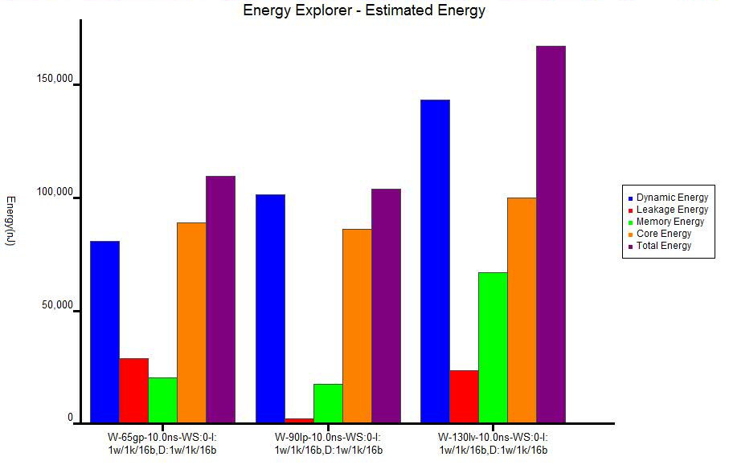
Estimate energy early and accurately
CPU
config
real
data
C/C++
code
Tensilica
Xtensa
Simulator
Tensilica
Xenergy
fab
process
&
libs
Tensilica
Xenergy
energy usage report

Slide 23
Experimentation yields lower power
CPU
config
real
data
C/C++
code
Tensilica
Xtensa
Simulator
Tensilica
Xenergy
fab
process
&
libs
Tensilica
Xenergy
energy usage report

Slide 24

Estimate energy early and accurately
The Tensilica Xenergy tool uses simulation of the real embedded software and real data on any Tensilica Xtensa processor configuration for any fab process technology to rapidly estimate the dynamic, leakage, core, and memory energy required to process that data with that software on that processor. This allows rapid experimentation on processor and software design that yields lower power designs than otherwise possible.
DISCLAIMER
not a Tensilica product

Slide 25
Important Power affecting decisions
Clock gating
Memory segmentation
Multi V_{T} and Multi V_{DD} design
Memory hierarchy structure
I/O voltages
Multiple voltage domains for use mode power down
Dynamic Voltage and Frequency Scaling (DVFS)
Synthesis constraints
Profiling with real software and data in Xenergy

Slide 26

Hyped power affecting decisions
Cadence CPF / Accellera UPF support!
Lowest mW/MHz!
Hardwired RTL!
caveat emptor

Slide 27

Ways for Users to Extend Battery Life
1. Turn down or turn off the display brightness
2. Turn off the cellular, WiFi, GPS, DTV radios
3. Turn down or turn off the sound volume
4. Have a larger or spare battery
5. Read a book or magazine

Slide 28
References
[1] Peters, Taglieri, Vemury Low Power Synthesis Flow For a Configurable Core SNUG Boston 2000
[2] Hillman, Wei Implementing Power Management IP for Dynamic and Static Power Reduction in Configurable Microprocessors using the Galaxy Design Platform at 130nm SNUG Boston 2004
[3] GadelRab, Bond, Reynolds Fight the Power: Power reduction ideas for ASIC designers and tool providers SNUG Boston 2005
[4] Biggs, Gibbons Aggressive Leakage Management in ARM Based Systems SNUG Boston 2006
[5] Wall, George Discussion Topic: Power Tensilica Confidential Presentation 2007

